Slide 1

Identifying differences in the omics of IR and IS prediabetics
Sabrina de Oliveira - I6155125
BMS Bachelor thesis 2020
Supervisors: Susan coort & martina kutmon
Bigcat
Maastricht university

Slide 2

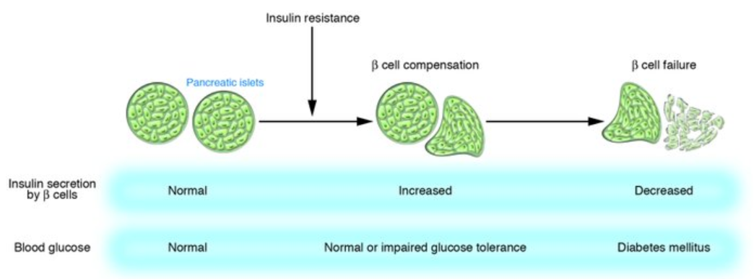

Introduction: T2DM
Importance:
2019: 463 million adults 2045: 700 million adults (1).
90-95% of all diabetes (2).
Pathophysiology:
51%
Normal
Increased
Decreased
Normal
Normal or increased
Diabetes
Adapted from (3)
Notes:
Pathophysiology:
https://www.ncbi.nlm.nih.gov/pmc/articles/PMC4226760/
https://www.emjreviews.com/diabetes/article/editors-pick-how-can-we-develop-more-effective-strategies-for-type-2-diabetes-mellitus-prevention-a-paradigm-shift-from-a-glucose-centric-to-a-beta-cell-centric-concept-of-diabetes/
T2DM is generally believed to develop after the onset of insulin resistance due to the beta cell dysfunction that results from the increased need for insulin secretion. This beta cell dysfunction is especially relevant since no production of new beta cells occurs past the age of 30 in the human pancreas. Hence, insulin resistance is believed to be a critical step in the development of T2DM. For this reason, great efforts are being made in order to investigate factors that influence insulin sensitivity.
References:
International Diabetes Federation. IDF Diabetes Atlas, 9th edn. Brussels, Belgium: 2019. Available at: https://www.diabetesatlas.org
American Diabetes Association. 2. Classification and diagnosis of diabetes: standards of medical care in diabetes—2019. Diabetes Care. 2019 Jan 1;42(Supplement 1):S13-28
Kasuga M. Insulin resistance and pancreatic β cell failure. The Journal of clinical investigation. 2006 Jul 3;116(7):1756-60.

Slide 3


Introduction: IR at the omics level
Host Metabolome
Microbial Metagenome
Host Proteome
↓ Bacteroidetes/Firmicutes
ratio in T2D. (4)
Genetic
predisposition (8)
Hypertriglyceridemia (6)
Unrestrained
gluconeogenesis (6)
IR
IR
IR
$↑$ BCAA (7)
Specific taxa = associated
with improved insulin
sensitivity or with insulin resistance (5)
Differential expression
of genes involved in
BCAA catabolism (9)
Notes:
Nevertheless, this interaction is still poorly understood and the changes in the omics of type 2 diabetic individuals remain debatable, especially in the time-period prior to diabetes onset.
References:
Zhang Y, Zhang H. Microbiota associated with type 2 diabetes and its related complications. Food Science and Human Wellness. 2013 Sep 1;2(3-4):167-72.
Gurung M, Li Z, You H, Rodrigues R, Jump DB, Morgun A, Shulzhenko N. Role of gut microbiota in type 2 diabetes pathophysiology. EBioMedicine. 2020 Jan 1;51:102590.
Ferrannini E, Gastaldelli A, Iozzo P. Pathophysiology of prediabetes. Medical Clinics. 2011 Mar 1;95(2):327-39.
Klein MS, Shearer J. Metabolomics and type 2 diabetes: translating basic research into clinical application. Journal of diabetes research. 2016 Jan 1;2016.
Sears DD, Hsiao G, Hsiao A, Yu JG, Courtney CH, Ofrecio JM, Chapman J, Subramaniam S. Mechanisms of human insulin resistance and thiazolidinedione-mediated insulin sensitization. Proceedings of the National Academy of Sciences. 2009 Nov 3;106(44):18745-50.
Komurcu-Bayrak E. Impact of genetic polymorphisms on insulin resistance. Insulin resistance. 2012 Dec 12.

Slide 4

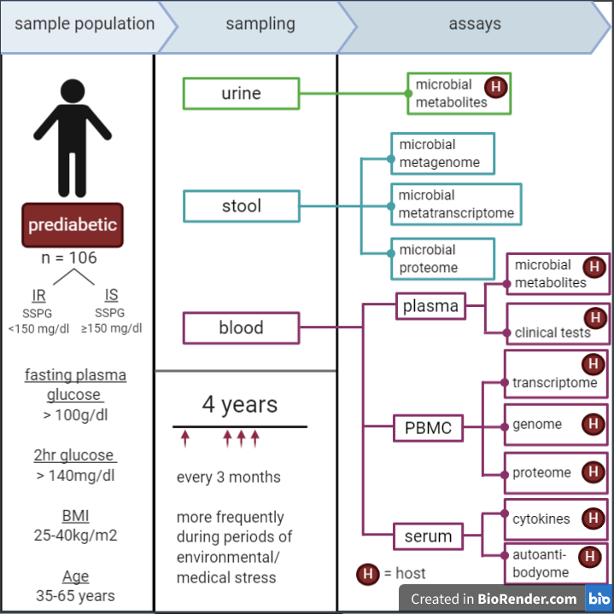
Aim
Investigate the changes in microbiome, host metabolome and host proteome between insulin resistant and insulin sensitive prediabetics.
Identify the biological consequences of these changes.
Sample population and general sampling protocol of the iHMP’s T2DM project. PBMC = peripheral blood monocytes. Figure adapted from an iHMP Research Network Consortium publication (10).
Notes:
References:
Integrative HM. The Integrative Human Microbiome Project: dynamic analysis of microbiome-host omics profiles during periods of human health and disease. Cell host & microbe. 2014 Sep 10;16(3):276.

Slide 5








Methods
Proteome data
Metabolome data
Metagenome data
iHMP T2DM data
Pre-processing
Isolated analysis of each omic
Combined analysis
Pathway analysis
(PathVisio & MetaboAnalyst)
Network Analysis
(Cytoscape)
60 subjects:
28 = IS
32 = IR
Subject data
Classification and data availability
Differential Analysis
(limma package)
Average per subject
Differential Analysis
(MetaboDiff package)
Average per subject
only HMDB included
Combined analysis
Filtering taxa (NA ranks & prevalence)
PCoA
PERMANOVA
Homogeneity check
Phyla abundances
Incl. samples in both
Excl. of outliers
Sparse CCA

Slide 6

PART Ia
Metagenome data

Slide 7

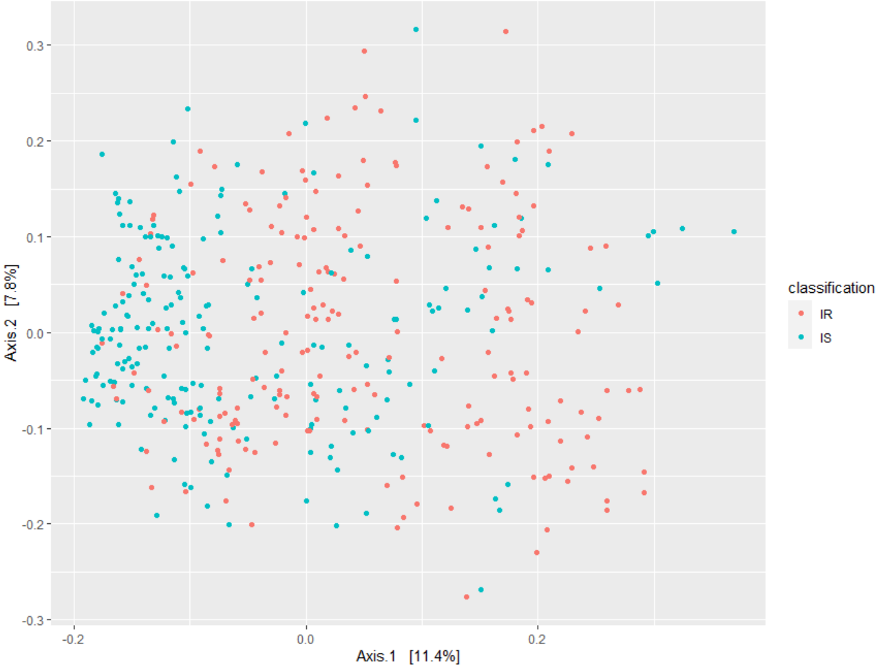
Results: PCoA Is there metagenomic separation between IR and IS?
All points = samples
Notes:
Check if groups are homogenous based on p-value!

Slide 8

Results: PERMANOVA Is this separation significant?
YES!
p = 0.010
Conclusion
The IR group likely has a distinct microbiome from the IS group.
BUT there also seems to exist differences within each group.
Notes:
adonis works by first finding the centroids for each group and then calculates the squared deviations of each of sample to that centroid. Then significance tests are performed using F-tests based on sequential sums of squares from permutations of the raw data. (https://chrischizinski.github.io/rstats/adonis/)
This could be due to subject characteristics that were not taken into account during the study, such as ethnicity.

Slide 9

Results: Homogeneity check What could explain this separation?
Could this separation be explained by different variances of the groups?
Method: Analysis of multivariate homogeneity of group variances
Result: p = 0.171
Conclusion
The metagenomic separation is unlikely to be the result of unequal variances between the 2 groups.

Slide 10

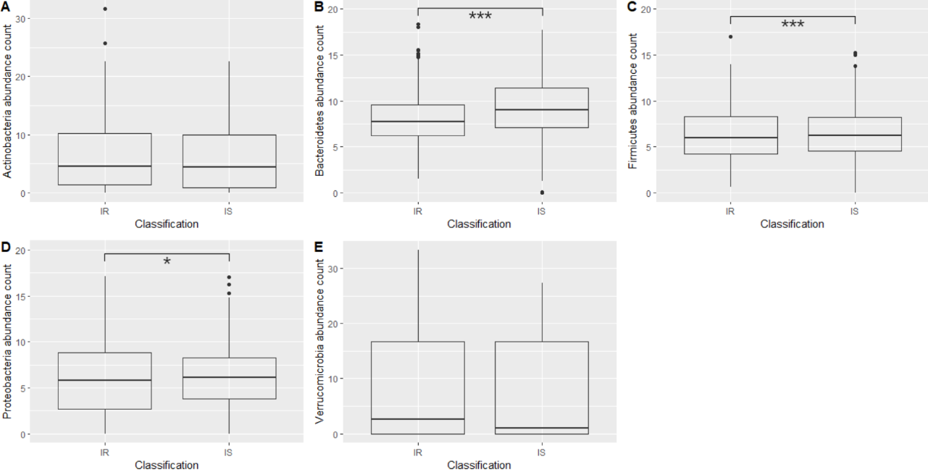
Results: Phyla abundances What could explain this separation?
*** = p < 0.0001, ** = p < 0.001 and * = p < 0.01

Slide 11
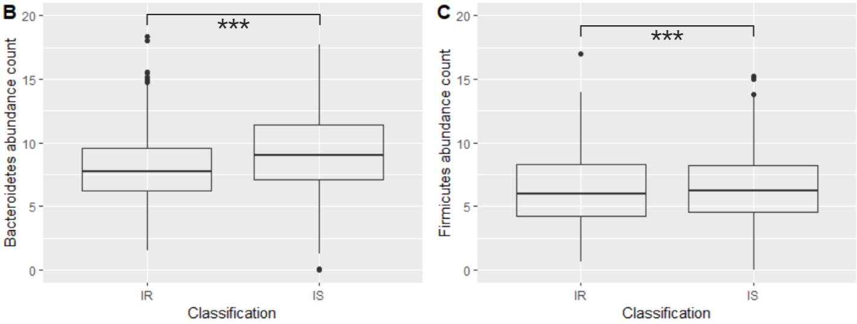

Discussion: Bacteroidetes/Firmicutes
11
↓ Bacteroidetes/Firmicutes
ratio in T2D. (4)
BUT very small change
Why?
↓ Bacteroidetes/Firmicutes ratio in obesity. (reference)
iHMP data: BMI = 25-40kg/m2
Conclusion
Small change could be due to the IS subjects also being obese. However, this small change does show an effect of IR independent of BMI.
Notes:
References:
Zhang Y, Zhang H. Microbiota associated with type 2 diabetes and its related complications. Food Science and Human Wellness. 2013 Sep 1;2(3-4):167-72.

Slide 12
PART Ib
12
Metabolome data
Metagenome data

Slide 13
Results: sparse CCA
13
Features best explaining the covariation between the metabolomic and metagenomic data
13 microbes
All = Firmicutes.
6 = Faecalibacterium prausnitzii
Remaining = Oscillospira, Coprococcus, Blautia or Dorea
11 metabolites
10 = monoacylglycerols with 1 of these being 2-arachidonoylglycerol (2-AG).
Remaining 1 = arachidonic acid.
Do these metabolites have a significantly different abundance between the 2 conditions?
Notes:
This method compares sets of features across high-dimensional data tables, where there may be more measured features than samples. In the process, it chooses a subset of available features that capture the most covariance – these are the features that reflect signals present across multiple tables.
https://www.bioconductor.org/help/course-materials/2017/BioC2017/Day1/Workshops/Microbiome/MicrobiomeWorkflowII.html#graph-based_analyses

Slide 14
PART II
14
Proteome data
Metabolome data

Slide 15
Results: Differential Analysis
15
What proteins/metabolites have sig. different abundances between IR and IS?
Proteomic
Metabolomic
Limma package
MetaboDIff package
P-value < 0.05: 23 proteins
P-value < 0.05: 40 metabolites
↑APOC4
↓APOD
↓ APOA1
↓ APOF
↑ CFH
↑ VTN
↓ IL1RAP
↑ C1QB
↓ C4A
↑ HP
↓ LPA
↓ 2-AG
↓ DHA
↑ L-glutamate
↑ Pyroglutamic acid
↑ Hexanoylcarnitine
↑ 3-hydroxydodenoic acid
↓ Ethylmalonic acid
Immune function
Lipid homeostasis
Energy homeostasis

Slide 16
Results: Combined Pathway Analysis
16
What pathways are most likely altered in IR compared to IS?
PathVisio
Expression criterion: p < 0.05
MetaboAnalyst
Selection criteria: p < 0.05
Pathway | Hits | logFC
IL-1 signalling | IL1RAP | -0.302
Signal transduction through IL1R | IL1RAP | -0.302
Structural Pathway of IL-1 | IL1RAP | -0.302
Thermogenesis | 2-AG | -0.758
PPAR alpha pathway | APOA1 PLTP | -0.301 -0.458
Pathway | Hits | logFC
Nitrogen metabolism | L-Glutamate | 0.288
D-Glutamine and D-glutamate metabolism | L-Glutamate | 0.288
Immune function
Lipid homeostasis
Energy homeostasis
Notes:
CHECK 15 METABOLITES? WHY NOT 40?

Slide 17
Discussion: Combined Pathway Analysis
17
Problem: all these pathways only contained 1-2 hits.
Are these pathway alterations large enough to result in noticeable differences between the IR and IS group?
Debateable: may be due to low coverage.
Possible solution: 1 tool with coverage of WikiPathways, KEGG and Reactome.
Network Analysis: Are there biological pathways that contain more than 2 of the significantly altered proteins/metabolites?
Notes:
CHECK 15 METABOLITES? WHY NOT 40?

Slide 18
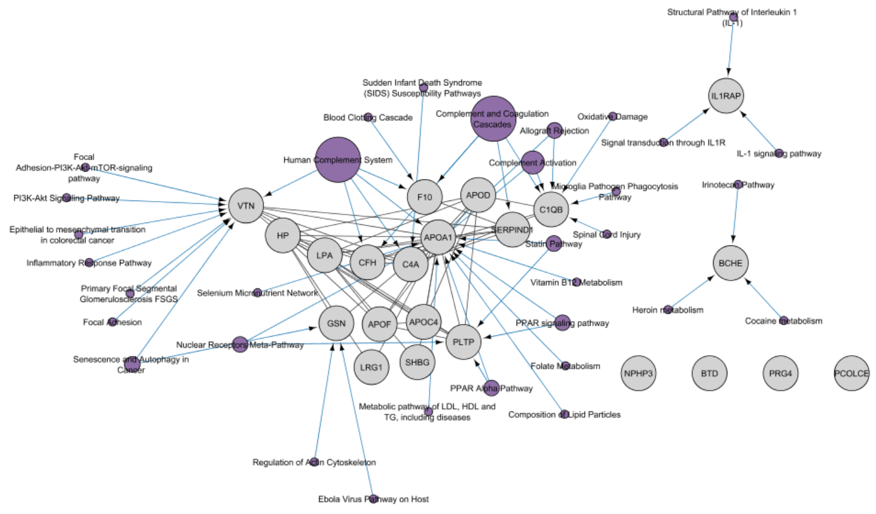
Results: Network Analysis
18
What pathways are most likely to be noticeably altered in IR compared to IS?
Pathways = purple.
Proteins (HGNC annotation) = grey.
Size of the pathway nodes represents their out-degree size.

Slide 19
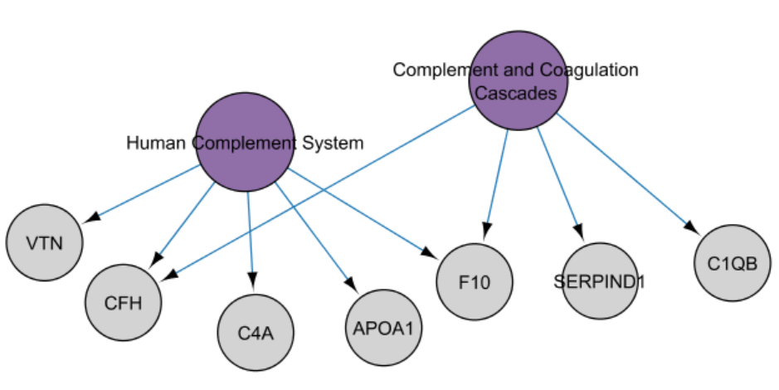
Results: Network Analysis
19
What pathways are most likely to be noticeably altered in IR compared to IS?
Both:
Contain > 3 significantly altered proteins.
Associated with the immune system.
Conclusion
Based on the proteomic differences of IR, it is most likely that IR is associated with noticeable changes in immune function.

Slide 20

What about the biological implications of the metagenomic differences?
20
Now that we know which metabolites are sig. altered in IR compared to IS, we can look at the sparse CCA more critically.

Slide 21
Discussion: sparse CCA
21
Host metabolome-microbiome interaction
13 microbes
All = Firmicutes.
6 = Faecalibacterium prausnitzii
Firmicute (↓ in IR)
Remaining = Oscillospira, Coprococcus, Blautia or Dorea
11 metabolites
10 = monoacylglycerols with 1 of these being 2-arachidonoylglycerol (2-AG).
Remaining 1 = arachidonic acid.
(12)
sig. ↓ in IR & involved in thermogenesis
(11)
Conclusion
The lower abundance of F.prausnitzii in IR may explain the lower 2-AG levels since it may be an indication of low A. muciniphila.
Cross-fed by Akkermansia muciniphila
Notes:
This method compares sets of features across high-dimensional data tables, where there may be more measured features than samples. In the process, it chooses a subset of available features that capture the most covariance – these are the features that reflect signals present across multiple tables.
https://www.bioconductor.org/help/course-materials/2017/BioC2017/Day1/Workshops/Microbiome/MicrobiomeWorkflowII.html#graph-based_analyses
Red box = problem with this conclusion.
Future perspectives.

Slide 22
Conclusions
22
Microbiome
Metabolome
Proteome
Significant separation between IR and IS (mainly due to Bacteroidetes)
40 metabolites with significantly different abundance in IR
23 proteins with significantly different abundance in IR
Although unable to conclude the concrete biological implications of the observed changes, this study can still be used to target future research towards the identification of preventative strategies for T2D
Association between microbiome composition and host metabolome cannot be determined.
Mainly associated with immune function, lipid homeostasis or energy homeostasis.
Immune function is the most likely to be noticeably altered.

Slide 23
Questions?

Slide 24
References
International Diabetes Federation. IDF Diabetes Atlas, 9th edn. Brussels, Belgium: 2019. Available at: https://www.diabetesatlas.org
American Diabetes Association. 2. Classification and diagnosis of diabetes: standards of medical care in diabetes—2019. Diabetes Care. 2019 Jan 1;42(Supplement 1):S13-28
Kasuga M. Insulin resistance and pancreatic β cell failure. The Journal of clinical investigation. 2006 Jul 3;116(7):1756-60.
Zhang Y, Zhang H. Microbiota associated with type 2 diabetes and its related complications. Food Science and Human Wellness. 2013 Sep 1;2(3-4):167-72.
Gurung M, Li Z, You H, Rodrigues R, Jump DB, Morgun A, Shulzhenko N. Role of gut microbiota in type 2 diabetes pathophysiology. EBioMedicine. 2020 Jan 1;51:102590.
Ferrannini E, Gastaldelli A, Iozzo P. Pathophysiology of prediabetes. Medical Clinics. 2011 Mar 1;95(2):327-39.
Klein MS, Shearer J. Metabolomics and type 2 diabetes: translating basic research into clinical application. Journal of diabetes research. 2016 Jan 1;2016.
Sears DD, Hsiao G, Hsiao A, Yu JG, Courtney CH, Ofrecio JM, Chapman J, Subramaniam S. Mechanisms of human insulin resistance and thiazolidinedione-mediated insulin sensitization. Proceedings of the National Academy of Sciences. 2009 Nov 3;106(44):18745-50.
Komurcu-Bayrak E. Impact of genetic polymorphisms on insulin resistance. Insulin resistance. 2012 Dec 12.
Integrative HM. The Integrative Human Microbiome Project: dynamic analysis of microbiome-host omics profiles during periods of human health and disease. Cell host & microbe. 2014 Sep 10;16(3):276.
Lopez-Siles M, Enrich-Capó N, Aldeguer X, Sabat-Mir M, Duncan SH, Garcia-Gil LJ, Martinez-Medina M. Alterations in the abundance and co-occurrence of Akkermansia muciniphila and Faecalibacterium prausnitzii in the colonic mucosa of inflammatory bowel disease subjects. Frontiers in cellular and infection microbiology. 2018 Sep 7;8:281.
Baptista LC, Sun Y, Carter CS, Buford TW. Crosstalk Between the Gut Microbiome and Bioactive Lipids: Therapeutic Targets in Cognitive Frailty. Frontiers in Nutrition. 2020 Mar 11;7:17.

Slide 25
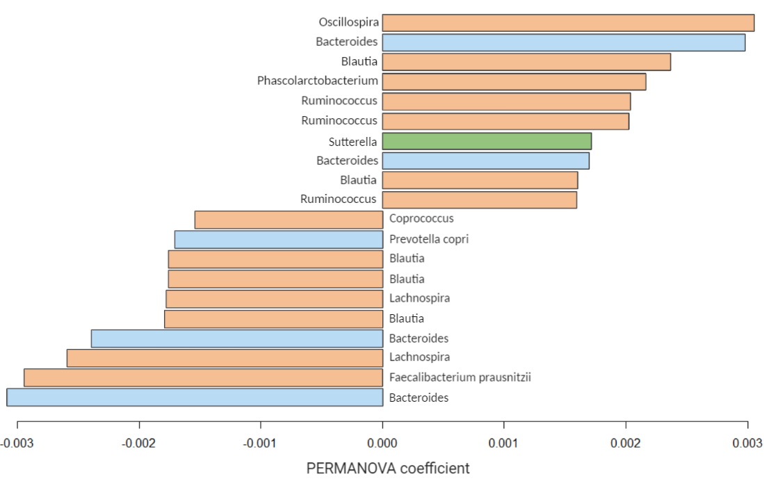
Results: Contributing microbes What could explain this separation?
11
Firmicutes
Bacteroidetes
Proteobacteria
More abundant in IR
Genus of microbes contributing the most to the metagenomic separation:
Oscillospira (phylum Firmicutes): more abundant in IR.
Bacteroides (phylum Bacteroidetes): less abundant in IR.
Less abundant in IR
Bar plot of the OTUs generated by the PERMANOVA deemed to contribute the most to the separation between the IS and IR groups.
For each OTU, the corresponding genus and species (if available) is given.
Notes:
PERMANOVA coefficient = the squared deviations of each of sample to the centroid of each group.

Slide 26
Discussion: Bacteroidetes/Firmicutes
11
Firmicutes
More abundant in IR
↓ Bacteroidetes/Firmicutes
ratio in T2D. (4)
Less abundant in IR
Bacteroidetes
Conclusion
Given the sample population, may be better to investigate the metagenomic differences at a level more specific than phylum.

Slide 27
Results: Combined Pathway Analysis
17
What pathways are most likely altered in IR compared to IS?
PathVisio
Expression criterion: p < 0.05
MetaboAnalyst
Selection criteria: p < 0.05
Pathway | Hits | logFC
IL-1 signalling | IL1RAP | -0.302
Signal transduction through IL1R | IL1RAP | -0.302
Structural Pathway of IL-1 | IL1RAP | -0.302
Thermogenesis | 2-AG | -0.758
PPAR alpha pathway | APOA1 PLTP | -0.301 -0.458
Pathway | Hits | logFC
Nitrogen metabolism | L-Glutamate | 0.288
D-Glutamine and D-glutamate metabolism | L-Glutamate | 0.288
Why use both?
Allows for a more detailed picture of the altered biological pathways.
Notes:
CHECK 15 METABOLITES? WHY NOT 40?

Slide 28
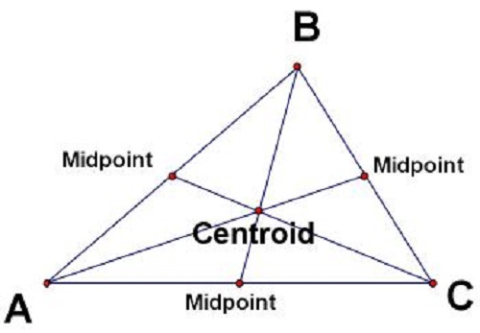
the centre of mass of a geometric object of uniform density.
http://www.differencebetween.net/science/difference-between-centre-of-gravity-and-centroid/

Slide 29
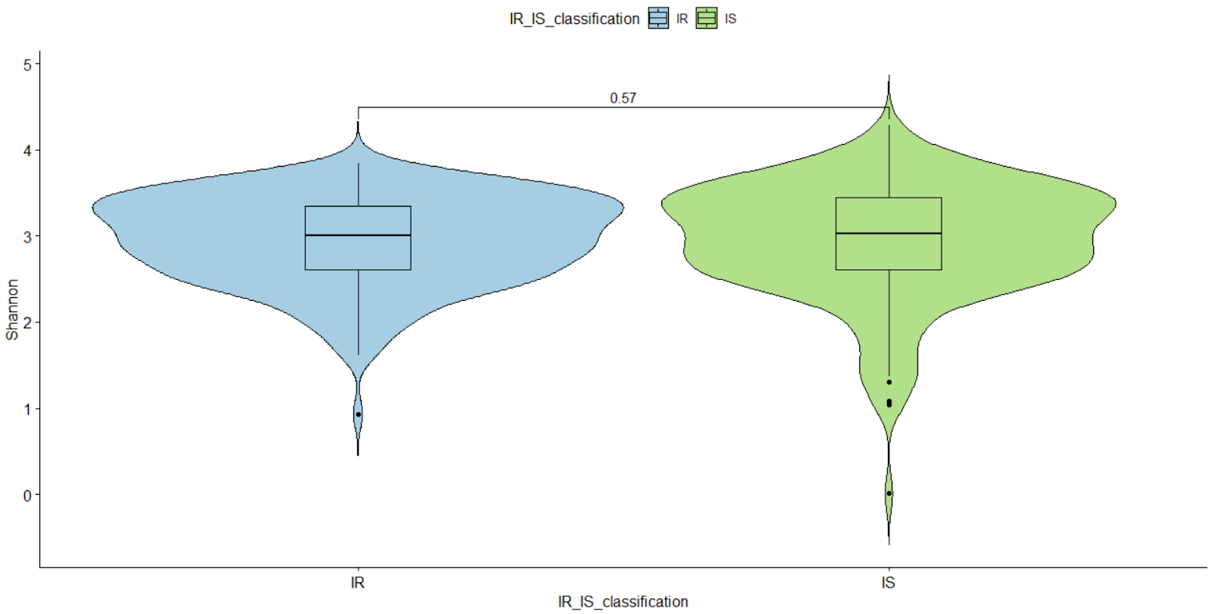
Results: 4 Shannon diversity
17
= measure of species diversity and evenness
Notes:
Species evenness refers to how close in numbers each species in an environment is.
Species abundance is the number of taxa per species

Slide 30
References
23
International Diabetes Federation. IDF Diabetes Atlas, 9th edn. Brussels, Belgium: 2019. Available at: https://www.diabetesatlas.org
American Diabetes Association. 2. Classification and diagnosis of diabetes: standards of medical care in diabetes—2019. Diabetes Care. 2019 Jan 1;42(Supplement 1):S13-28
Saisho Y. How Can We Develop More Effective Strategies for Type 2 Diabetes Mellitus Prevention? A Paradigm Shift from a Glucose-Centric to a Beta Cell-Centric Concept of Diabetes. DIABETES. 2018 Nov.
Integrative HM. The Integrative Human Microbiome Project: dynamic analysis of microbiome-host omics profiles during periods of human health and disease. Cell host & microbe. 2014 Sep 10;16(3):276.

